Slide 1
Figures Revision
Figure 6-10

Slide 2
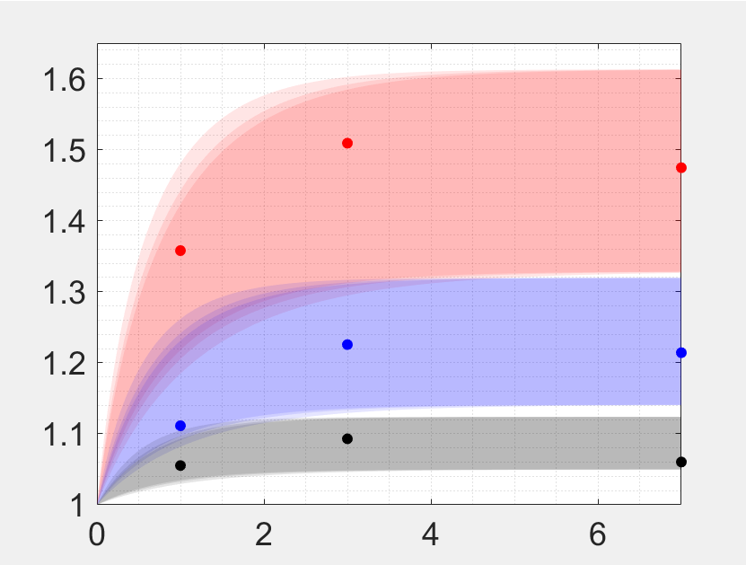
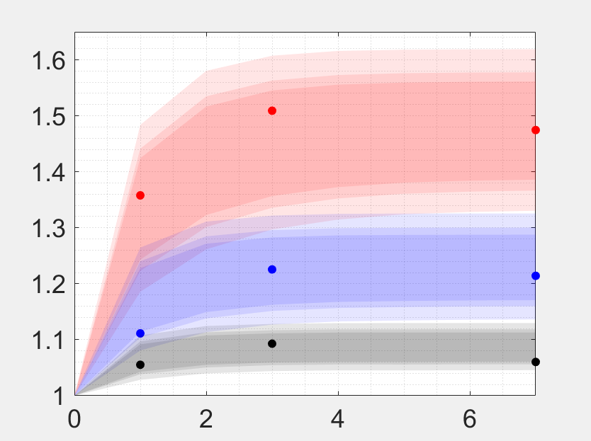

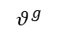
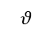
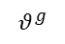
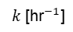
Reedited F6
a
b
c
Apex
Intermediate
Peripheral
Apex
Intermediate
Peripheral
Frequency
$$θ^{g}$$
$$θ^{g}$$
$$k \text{[}{\text{hr}}^{−1}\text{]}$$
Time [days]
Time [days]
d
1 Day
3 Days
7 Days
$$θ^{g}$$
$$θ$$
$$θ$$
$$θ$$

Slide 3
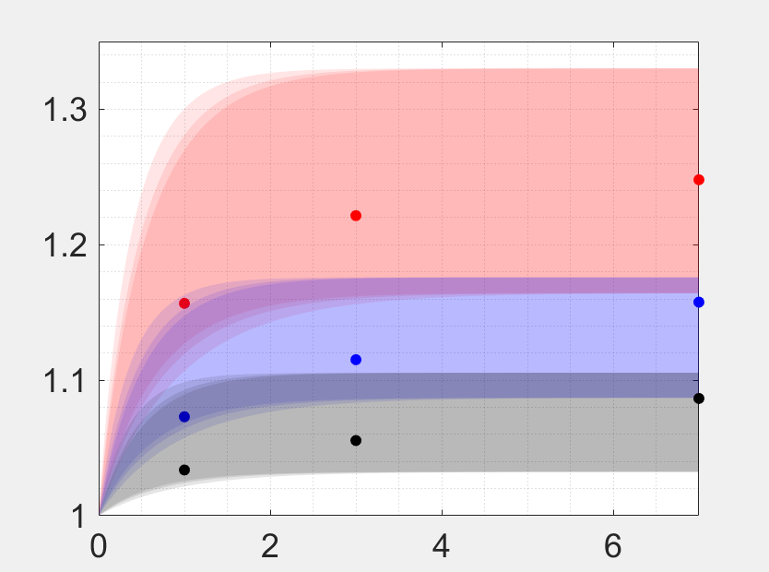
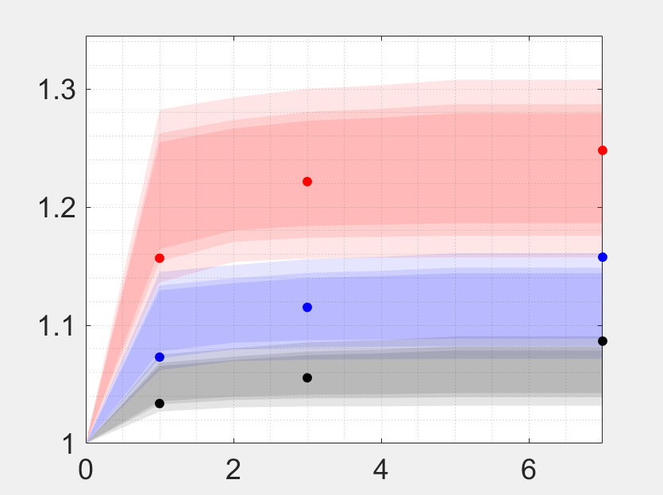
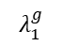
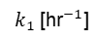
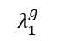
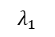
Reedited F7
a
b
c
Apex
Intermediate
Peripheral
Apex
Intermediate
Peripheral
Frequency
$$λ_{1}^{g}$$
$$λ_{1}^{g}$$
$$k_{1} \text{[}{\text{hr}}^{−1}\text{]}$$
Time [days]
Time [days]
d
1 Day
3 Days
7 Days
$$λ_{1}^{g}$$
$$λ_{1}$$
$$λ_{1}$$
$$λ_{1}$$

Slide 4
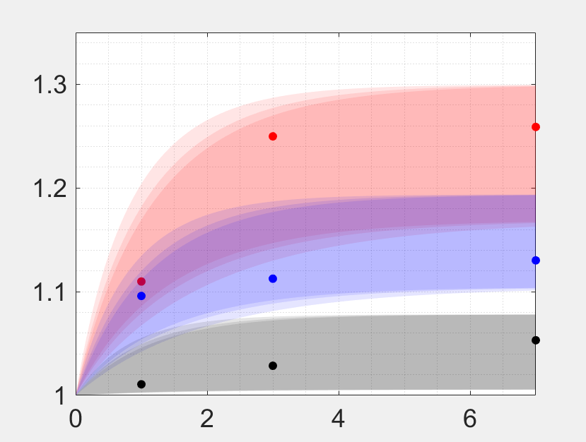
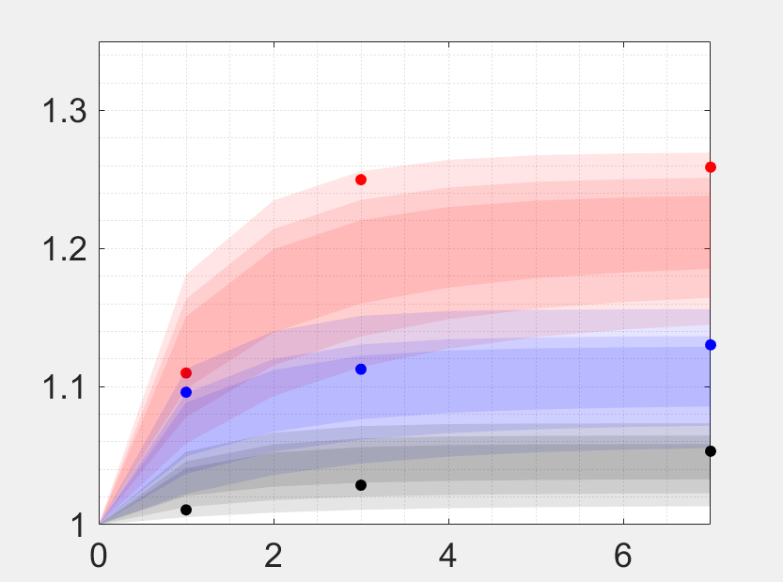
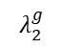
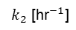
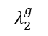
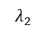
Reedited F8
a
b
c
Apex
Intermediate
Peripheral
Apex
Intermediate
Peripheral
Frequency
$$λ_{2}^{g}$$
$$λ_{2}^{g}$$
$$k_{2} \text{[}{\text{hr}}^{−1}\text{]}$$
Time [days]
Time [days]
d
1 Day
3 Days
7 Days
$$λ_{2}^{g}$$
$$λ_{2}$$
$$λ_{2}$$
$$λ_{2}$$

Slide 5
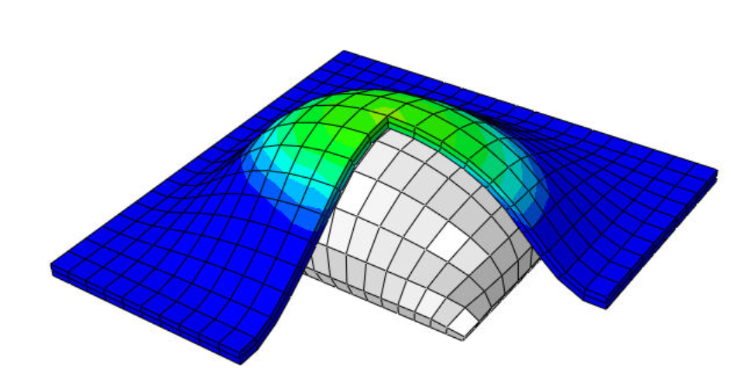
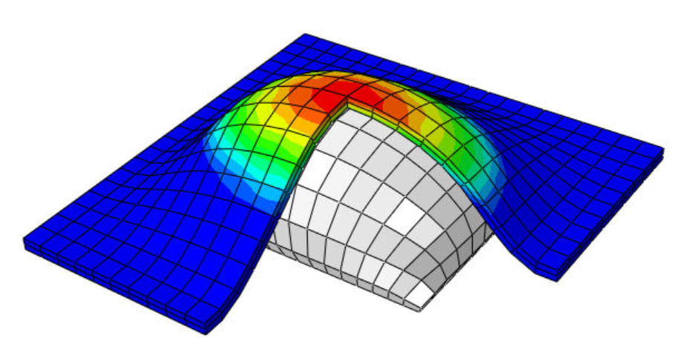
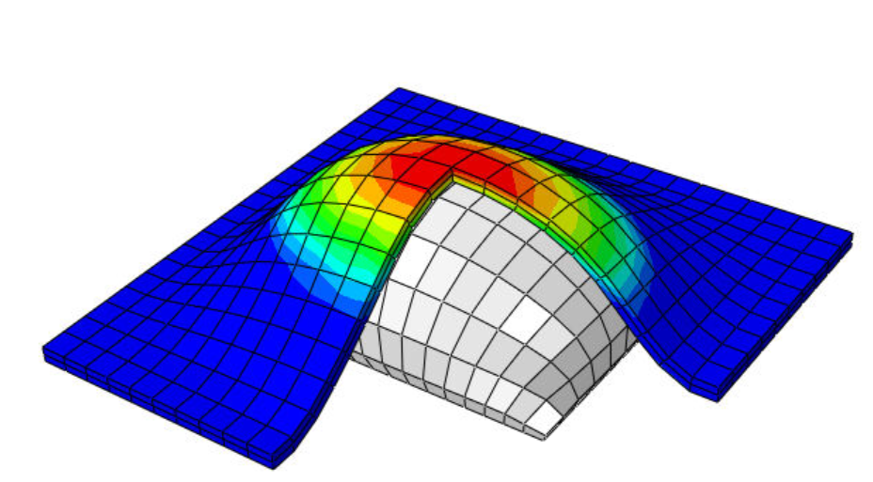
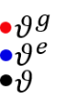
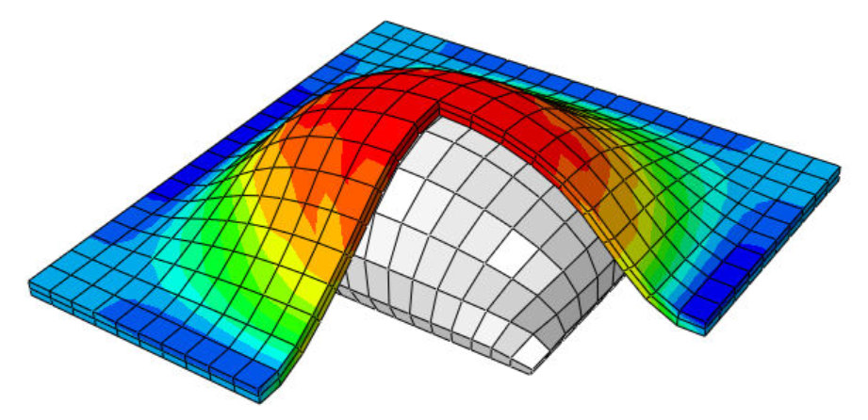
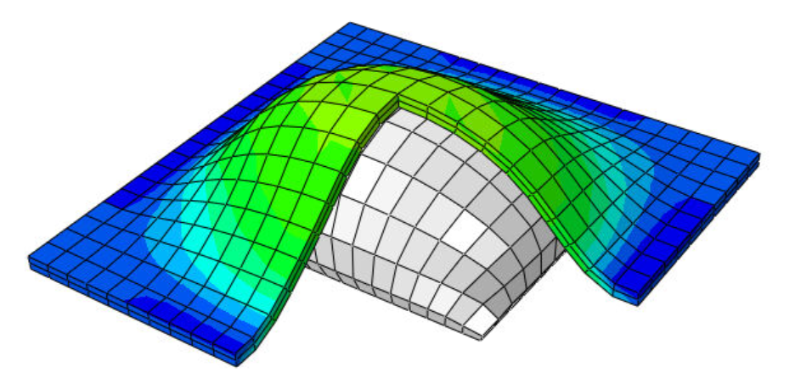
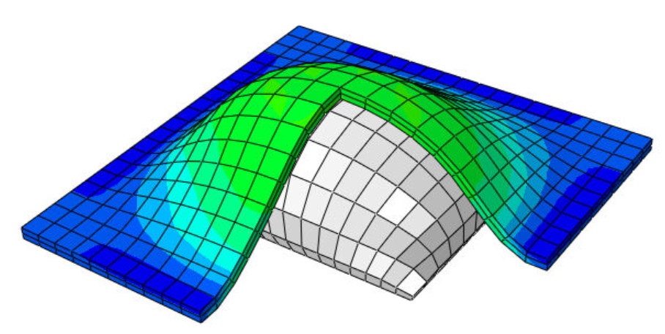
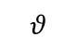
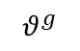
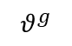
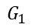
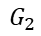
$$θ$$
$$G_{2}$$
$$θ^{g}$$
$$G_{1}$$
1 Day
3 Days
7 Days
$$θ^{g}$$
1 Day
3 Days
7 Days
Notes:
Code in the folder CompareResults(Figure6-10),
Th_thg_thePlotFigure_9.m

Slide 6
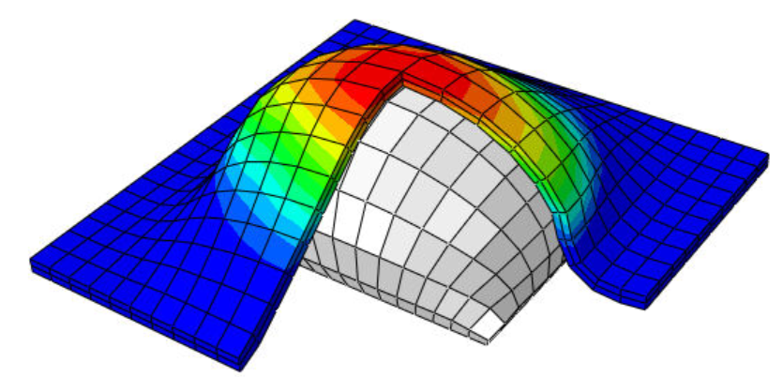
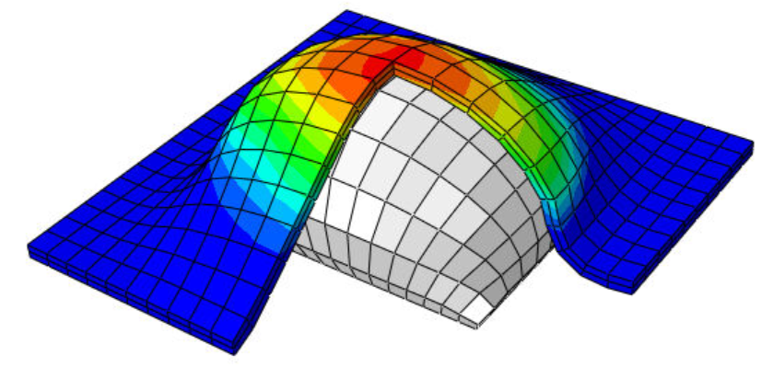
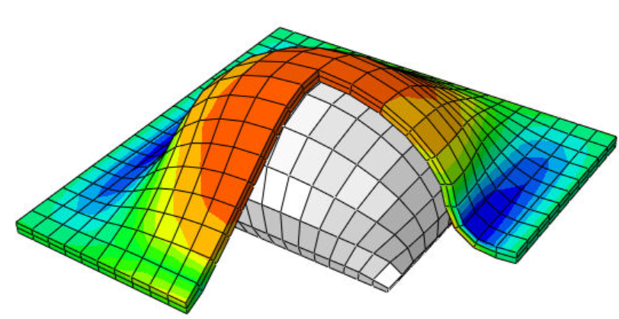
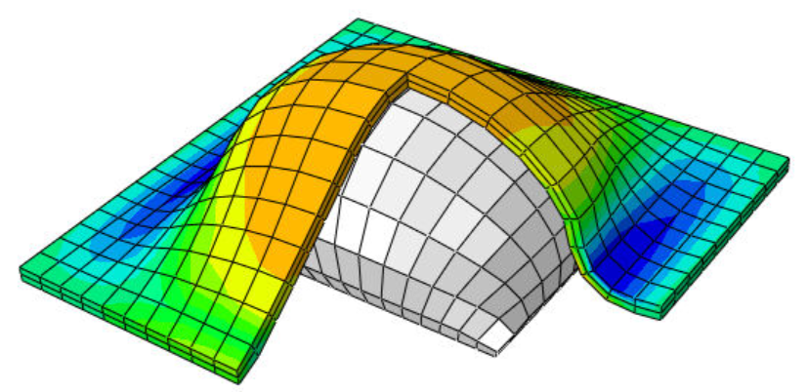
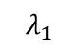
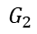
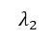
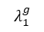
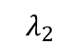
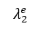
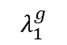
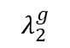
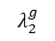
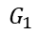
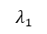
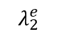
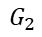
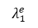
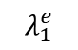
$$G_{2}$$
$$λ_{1}^{g}$$
$$G_{2}$$
$$λ_{2}^{g}$$
$$λ_{1}$$
$$λ_{2}$$
$$G_{1}$$
$$λ_{1}^{g}$$
$$G_{1}$$
$$λ_{2}^{g}$$
$$λ_{1}^{e}$$
$$λ_{2}^{e}$$
$$λ_{1}$$
$$λ_{2}$$
$$λ_{1}^{e}$$
$$λ_{2}^{e}$$
Time [days]
Time [days]
Notes:
Code in the folder CompareResults(Figure6-10),
Th_thg_thePlotFigure_10.m

